Slide 1
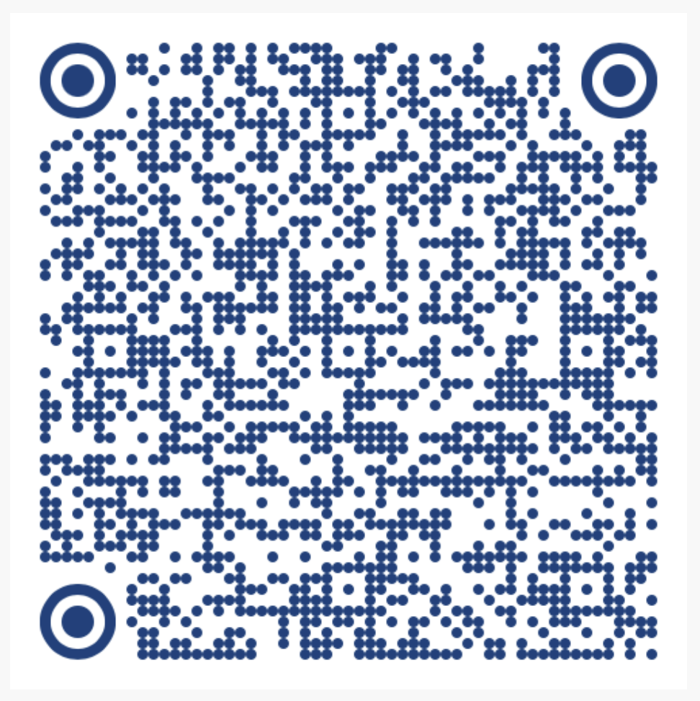
Explaining Protein Folding with Integrated Gradients and Attention
From Integrated Gradients to Pair-wise Attention in AlphaFold
Sumit Kumar Jha (Eminent Scholar Chair Professor of Computer Science, Florida International University) Rukmangadh Sai Myana (PhD student, Department of Computer Science, Florida International University)
13th International Conference on Computational Advances in Bio and Medical Sciences (ICCABS) 2025 Presented at Georgia State University
Presenter: Sumit
Extended 25-page manuscript

Slide 2
Protein Folding Models
1
Google DeepMind's AlphaFold 3 is a revolutionary AI model for predicting biomolecular structures.
2
It predicts protein structures in mere seconds, dramatically accelerating what used to be a years-long process.
3
This breakthrough has far-reaching implications for drug discovery, vaccine development, understanding enzyme activity, and analyzing biological reactions.
4
Researchers now have unparalleled insights into protein dynamics and interactions, driving advancements in biomedicine.
5
Validated by rigorous research, AI models like AlphaFold 3 promise to accelerate innovation and transform healthcare.

Slide 3
Explaining Protein Folding Models
Understanding protein folding is crucial for deciphering the link between a protein's structure and its biological function.
While models like AlphaFold2 accurately predict protein structures, their inner workings remain opaque.
This presentation seeks to explore explainable AI (XAI) to illuminate these mechanisms and try to reveal the key amino acid residues influencing protein structure and function.
But our results are not very positive yet!

Slide 4
Context and Motivation
Deep learning models like AlphaFold have revolutionized structural biology, enabling highly accurate protein structure prediction. However, despite their predictive power, these complex models lack interpretability, hindering trust in critical applications such as drug discovery and clinical diagnostics.
Our Focus in This Work
Evaluate the effectiveness of Integrated Gradients (IG) and Integrated Directional Gradients (IDG) for explaining intricate protein folding models.
Introduce Pair-wise Attention, leveraging internal representations from AlphaFold2's Evoformer stack to provide deeper insights.
Comparatively analyze these methods, both quantitatively and qualitatively, across diverse proteins (e.g., Protein G, Conotoxin, Hylin-a1), demonstrating the practical value of our approach.

Slide 5
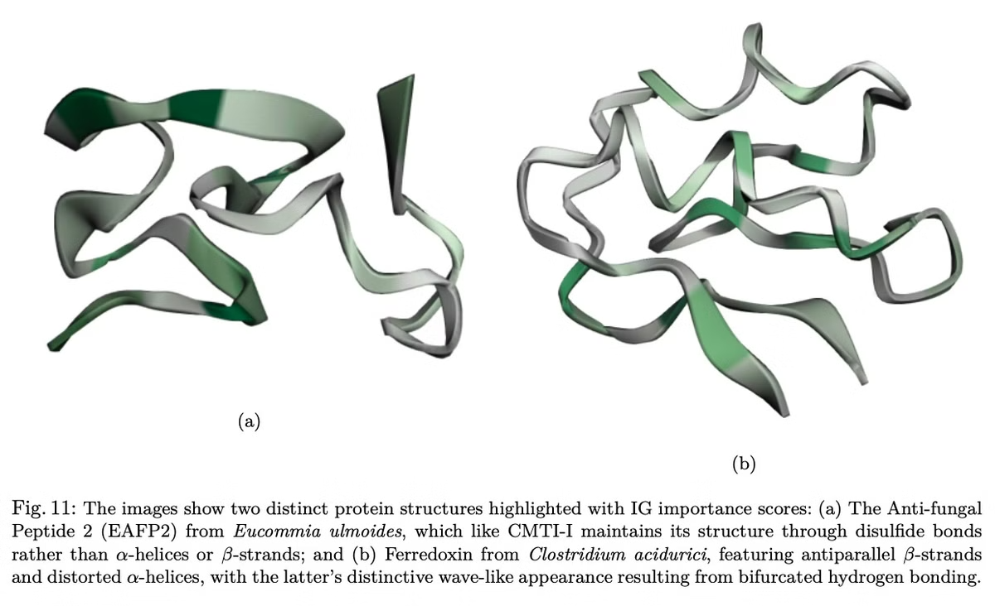
Proteins Investigated
This study investigated 10 proteins, including:
B1 domain of Streptococcal Protein G
Sso10a (Sulfolobus solfataricus)
α-conotoxin RgIA
Trypsin Inhibitor I (CMTI-I)
Conantokin-T (Con-T)
Ferredoxin (Clostridium acidurici)
Humanin (Homo sapiens)
Hylin-a1 (Boana albopunctata)
Anti-fungal Peptide 2 (EAFP2)
Pancreatic Polypeptide (PP)

Slide 6
Ground Truth: Sources and Computation
Evolutionary Conservation Scores
Tool: ConSurf
Computation: Calculated from multiple sequence alignments (MSAs) of homologous proteins. These scores highlight residues conserved due to structural or functional importance.
Purpose: Identifies residues critical for protein stability and function.
Interaction Energies
Tool: ProDy
Computation: Interaction matrices quantify molecular forces (hydrogen bonds, van der Waals forces, ionic interactions). This helps identify energetically favorable interactions crucial for stability.
Mayrose,I., Graur,D., Ben-Tal,N. and Pupko,T. (2004)
Mol. Biol. Evol., 21, 1781-1791.
Zhang S, Krieger JM, Zhang Y, Kaya C, Kaynak B, Mikulska-Ruminska K, Doruker P, Li H, Bahar I.
ProDy 2.0: Increased Scale and Scope after 10 Years of Protein Dynamics Modelling with Python.
Bioinformatics 2021 37(20):3657-3659.

Slide 7
Measuring Input Feature Importance
Understanding a model's prediction often hinges on identifying the most influential input features.
For a simple linear model, such as F(x, y, z) = 5x + 3y + 2z, the importance of each feature is directly reflected in its partial derivative (e.g., ∂F/∂x).
∂F/∂x = 5
∂F/∂y = 3
∂F/∂z = 2
This concept extends to nonlinear models like output = 5e^x + 3e^y + 2e^z, where despite nonlinearities, the relative importance can often be estimated using similar derivative-based methods.
For instance, when x=0, y=0, and z=0, it's clear that x has a greater impact than y, and y more than z.

Slide 8
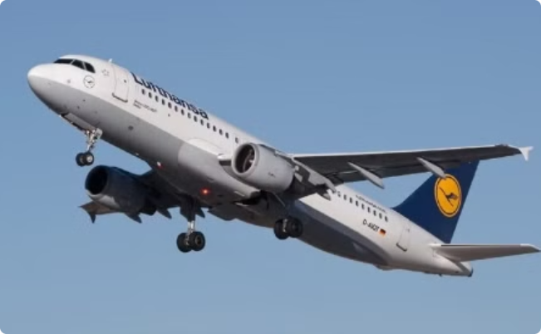
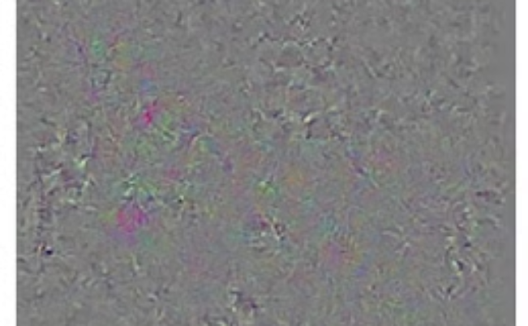
Where Simple Gradients Fail
1
Key Points
2
Airplane Example
In large, complex deep learning models, gradients can highlight areas of noise or unimportant features.
Image-based gradient methods may fail to outline the plane accurately.
Empirical stats show low correlation between raw gradients and "true" salient regions.
As gradients saturate during training of deep learning models.
Gradient Statistics:
Maximum: 0.24790948629379272
Average: 0.01491297036409378
Airplane in flight
Gradients for predicted class: airliner

Slide 9
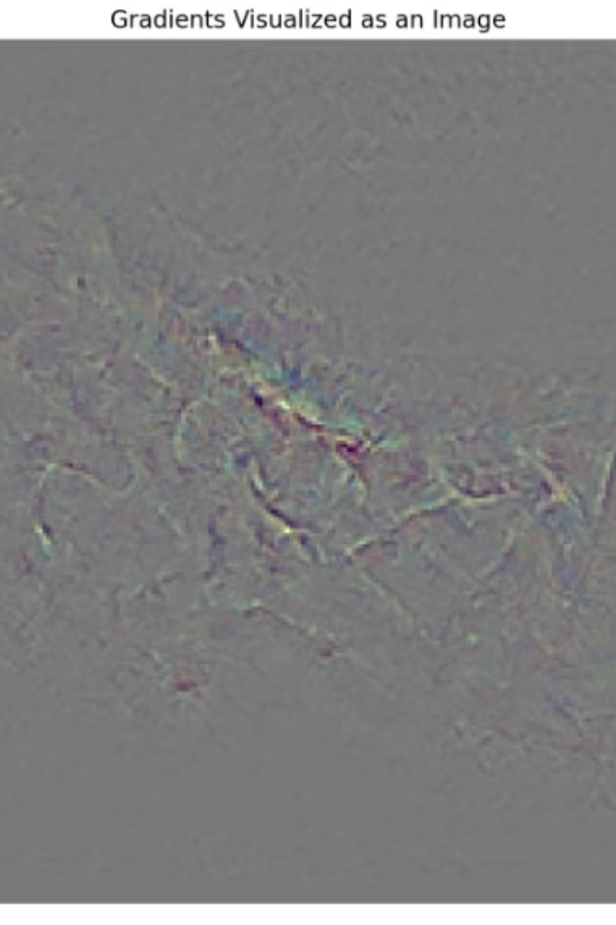
Gradients of Scaled Input
We scaled the input by a factor of 0.025 (I′ = 0.025 × I) and observed the changes. The new visualization illustrates the resulting gradients.
Maximum: 1.3746
Average: 0.032669
The average gradient value has now more than doubled compared to the original, unscaled input.
Scaling the input can amplify gradient averages, emphasizing the sensitivity of gradient-based methods to input magnitude.
for deep learning models

Slide 10
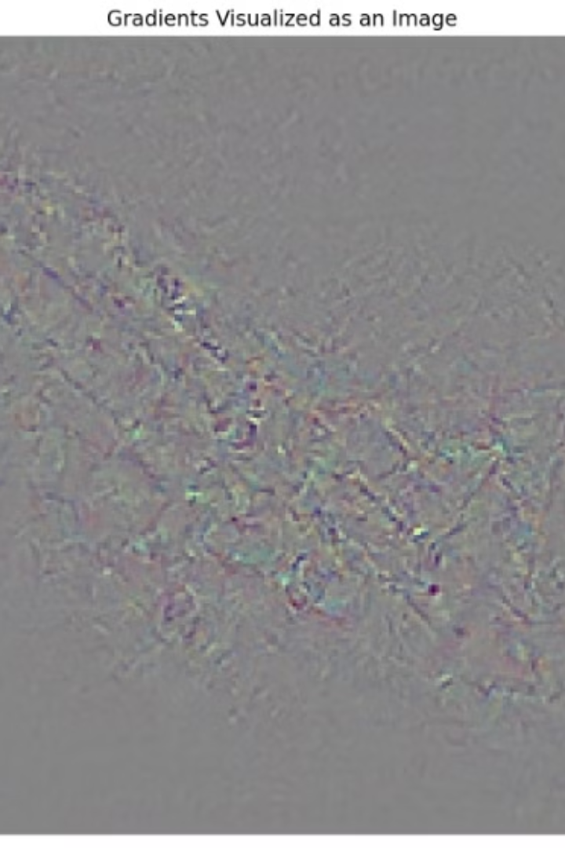
Gradients of Scaled Input
We scaled the image by a factor of 0.05 (I′ = 0.05 × I) and observed the changes. The new visualization illustrates the resulting gradients.
Statistics for the raw gradients with the 0.05 scaled input are as follows:
Maximum: 1.0487
Average: 0.034984
The average gradient value more than doubled compared to the unscaled input.
This amplification of gradient magnitudes by input scaling can help the interpretability of gradient-based explanations.

Slide 11
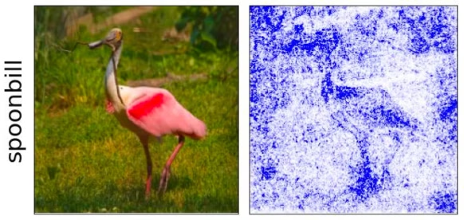
Introducing Integrated Gradients (IG)
Integrated Gradients (IG) explains deep learning model predictions.
Unlike traditional gradients, IG computes gradients along a path from baseline (x′) to actual input (x).
This path integral accumulates gradient contributions for better understanding.
Mathematically, IG is defined as:
where:
x′: Baseline input (e.g., a black image).
x: Actual input.
α: Scaling factor interpolating between x′ and x.
F: Model's output function.
Key properties of IG (from literature):
Completeness: Sum of attributions equals difference between function values at x and x′.
Sensitivity: Features with no effect have zero attribution.
Implementation Invariance: IG results are invariant to mathematically equivalent representations.
Sundararajan M, Taly A, Yan Q. Axiomatic attribution for deep networks. InInternational conference on machine learning 2017 Jul 17 (pp. 3319-3328). PMLR.
IG's path integral uniquely satisfies these axioms.

Slide 12
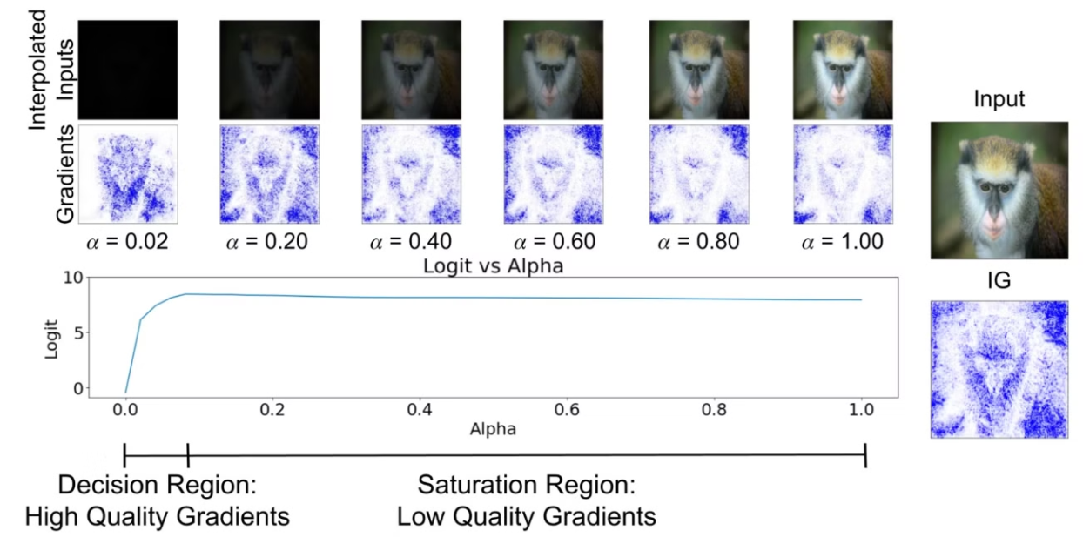
Limitations of Integrated Gradients (IG)
Uniform Sampling and Vanishing Gradients: Integrated Gradients (IG) uniformly samples points along the path from baseline to input. However, gradients often diminish near the input, especially in deep learning models. This can lead to inaccurate attributions.
Key Takeaway: IG's uniform sampling doesn't account for varying gradient sensitivity, potentially reducing interpretability.

Slide 13
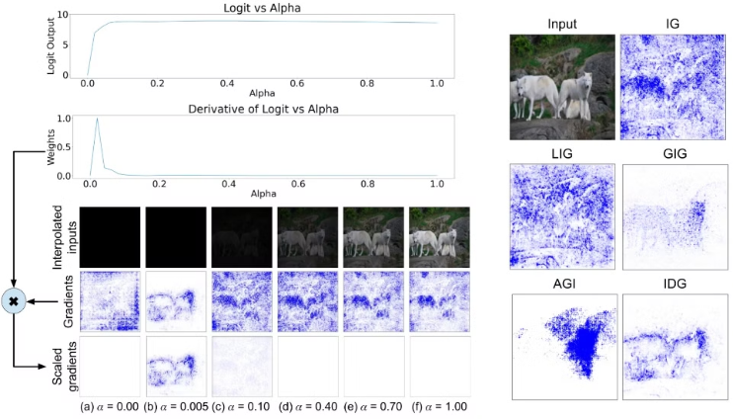
Integrated Directional Gradients (IDG)
Our AAAI 2024 paper introduced IDG. IDG uses a biased sampling approach.
This is achieved by incorporating the derivative of the output function (∂F/∂α) into the path integral:
Walker C, Jha S, Chen K, Ewetz R. Integrated decision gradients: Compute your attributions where the model makes its decision. In Proceedings of the AAAI Conference on Artificial Intelligence 2024 Mar 24 (Vol. 38, No. 6, pp. 5289-5297).

Slide 14
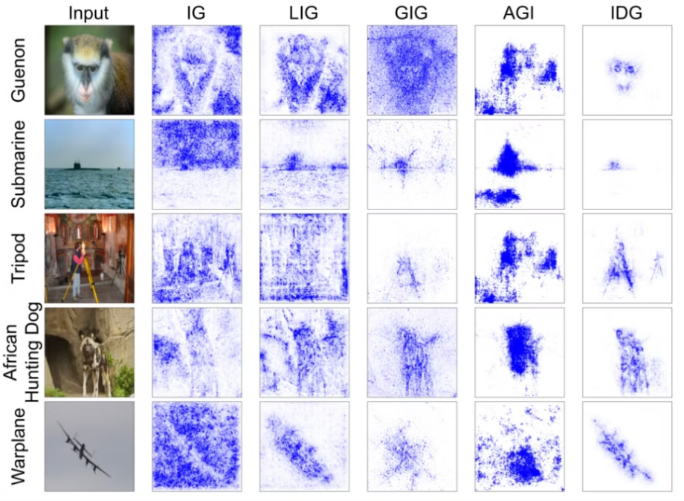
IDG: Visual & Comparative Results
Visualizations from our AAAI 2024 paper directly compare IG and IDG across various test models. These figures highlight IDG's ability to capture key regions of interest with sharper, more focused attributions.

Slide 15
Applying XAI to Protein Folding Models
AlphaFold2 achieves strong performance through specialized attention mechanisms and a two-module design.
AlphaFold2's two main modules are the Evoformer and the Structure Module.
The Evoformer embeds evolutionary and structural context by processing multiple sequence alignments (MSAs) and pair representations.
The Structure Module then refines these representations to produce 3D coordinates.
Since prior work indicates the Evoformer drives structural learning, we focus on explaining its internal embeddings.

Slide 16
XAI Methods: IG, IDG, and Pair-wise Attention (PA)
This work uses three explainable AI (XAI) methods to analyze protein folding models:
Integrated Gradients (IG): Attributes input importance using a path integral approach.
Integrated Directional Gradients (IDG): Extends IG by incorporating ∂F/∂α to focus on regions with significant output changes.
Pair-wise Attention (PA): Focuses on attributions within the Evoformer's "Learned Pair Representation," hypothesizing that this better captures residue-residue interactions.
These XAI methods are applied at two levels:
Input Gradients: IG and IDG assess the importance of individual residue-level features.
Evoformer Gradients: Analyze attributions relative to the Learned Pair Representation to understand residue-residue interactions.

Slide 17
Pair-wise Attention Scores
Pairwise attention (PA) scores are calculated using the following formula:
Ax: Represents the learned pair representation within the Evoformer module.
A': Represents the baseline pair representation.
Key Differences Compared to Integrated Gradients (IG) and Integrated Directional Gradients (IDG):
PA operates on the gradients (∇) within the learned embedding space of the Evoformer, rather than the raw input feature space. This approach offers a more direct analysis of residue-residue interactions within the model's internal representation.
PA is potentially more effective at capturing essential residue interactions, such as disulfide bonds and hydrogen bonding, which are crucial for protein folding.

Slide 18
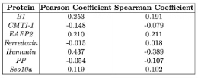
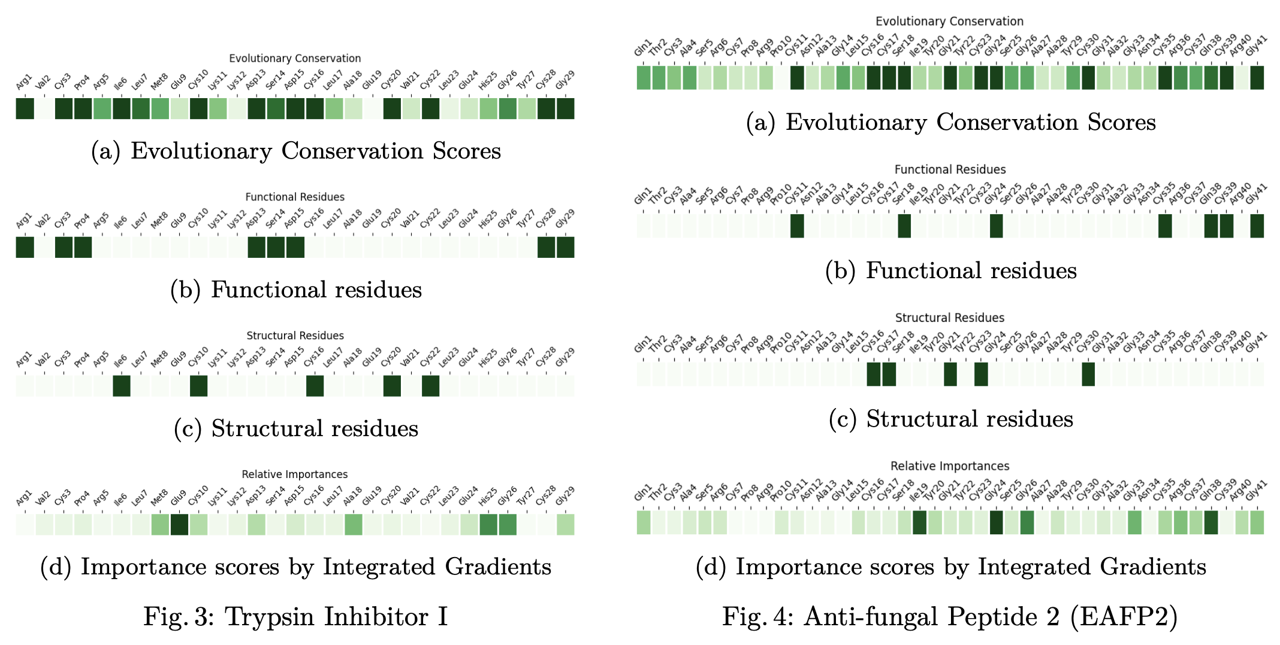
IG Does Not Explain the Model Well
Correlation Analysis: Integrated Gradients (IG) scores show poor correlation with evolutionary conservation, as evident in the following:
Trypsin Inhibitor I — IG highlights certain residues, but there is little overlap with functional or structural residues identified by evolutionary conservation.
Anti-fungal Peptide 2 (EAFP2) — Similar mismatches between IG scores and known residue importance.

Slide 19
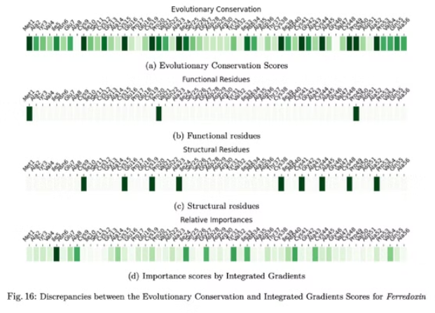
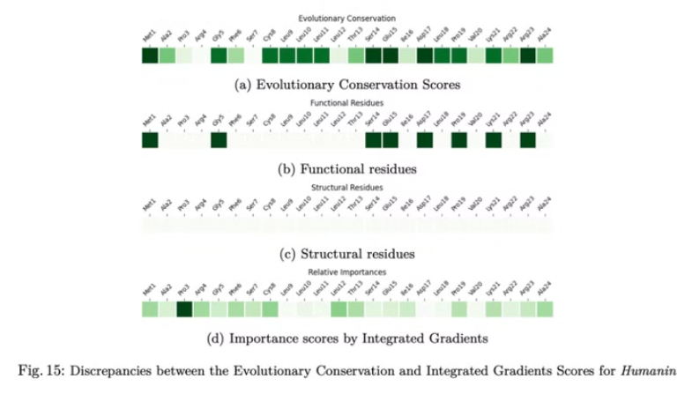
IG Results: Humanin and Ferredoxin
Humanin: IG overemphasizes residues that are not highly conserved, missing key functional residues.
Ferredoxin: IG attributions fail to highlight the cysteine residues, critical for the protein's structural and functional integrity.

Slide 20
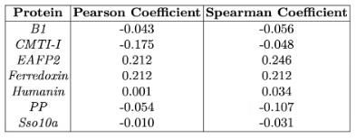
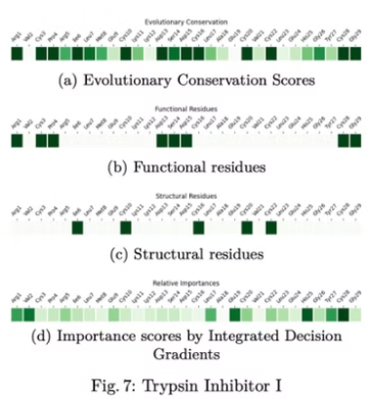
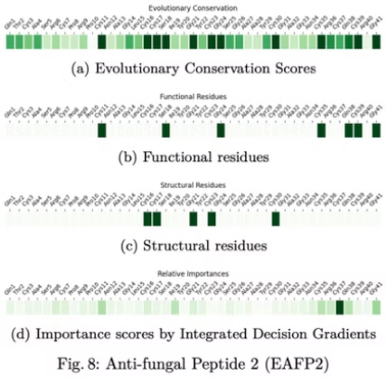
IDG Does Not Explain the Model Well
Correlation Analysis: IDG correlations with evolutionary conservation are as poor as IG, with negative or near-zero coefficients.
Trypsin Inhibitor I — IDG does not emphasize key disulfide bonds crucial for stability.
Anti-fungal Peptide 2 — Similar failure to capture critical residues.

Slide 21
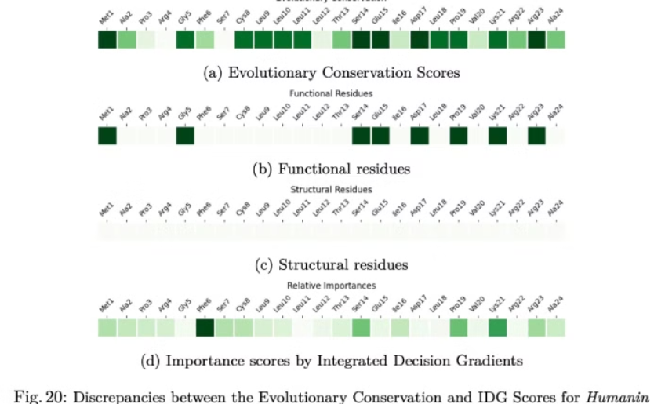
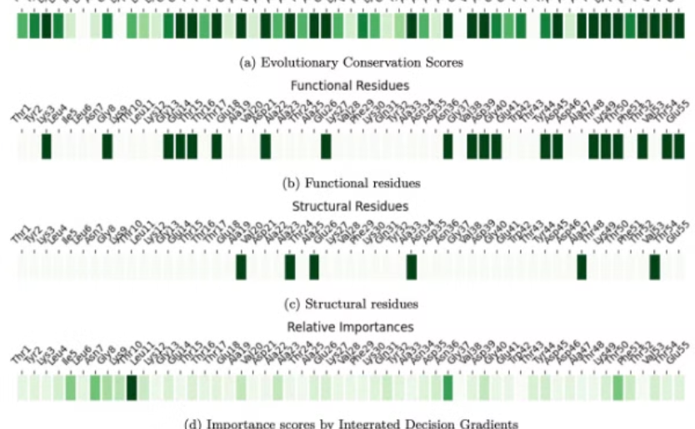
IDG Results: Humanin and B1 Domain
Humanin: IDG slightly improves over IG by emphasizing the helix, but misses residues at the termini where binding occurs.
B1 Domain: IDG fails to highlight residues forming the hydrophobic core and β-strands critical for protein stability.
Humanin
B1 Domain

Slide 22
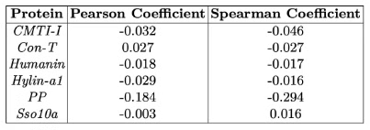
PA: A Step Forward?
PA shows low correlation with interaction energy matrices across proteins, failing to consistently identify inter-residue interactions.
Trypsin Inhibitor — PA misses disulfide bonds essential for structure.
Hylin-a1 — PA does not highlight (i, i+3) hydrogen bonding expected in an α-helix.

Slide 23
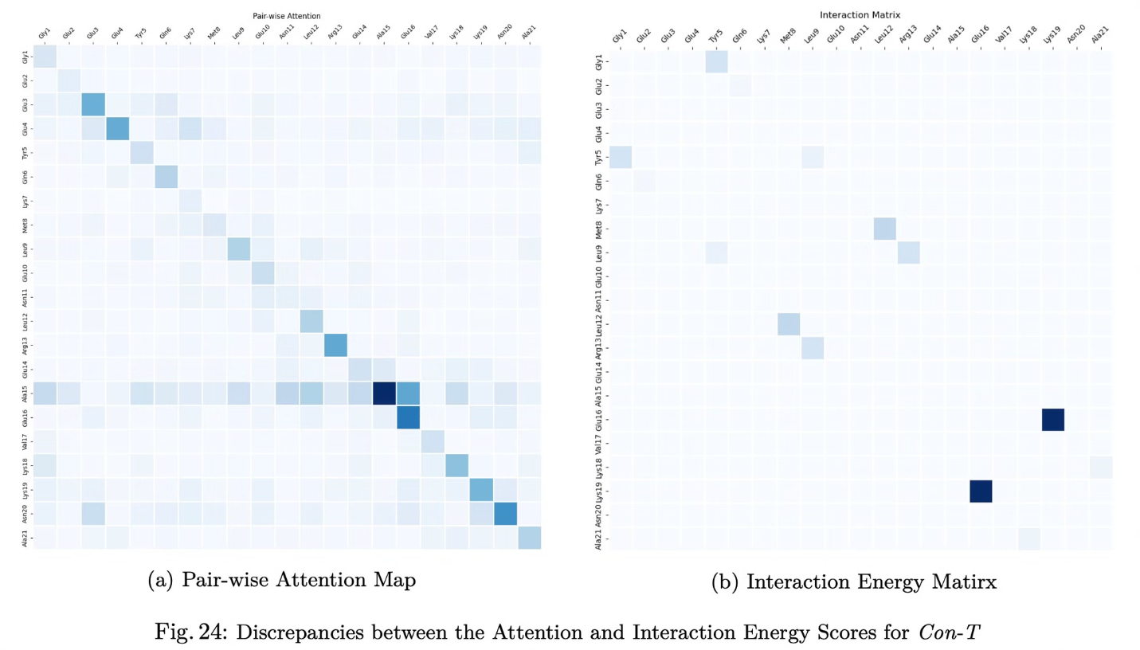
PA Results: Con-T and Humanin
Con-T: PA misses key interactions, such as hydrogen bonds and disulfide linkages critical for stability.

Slide 24
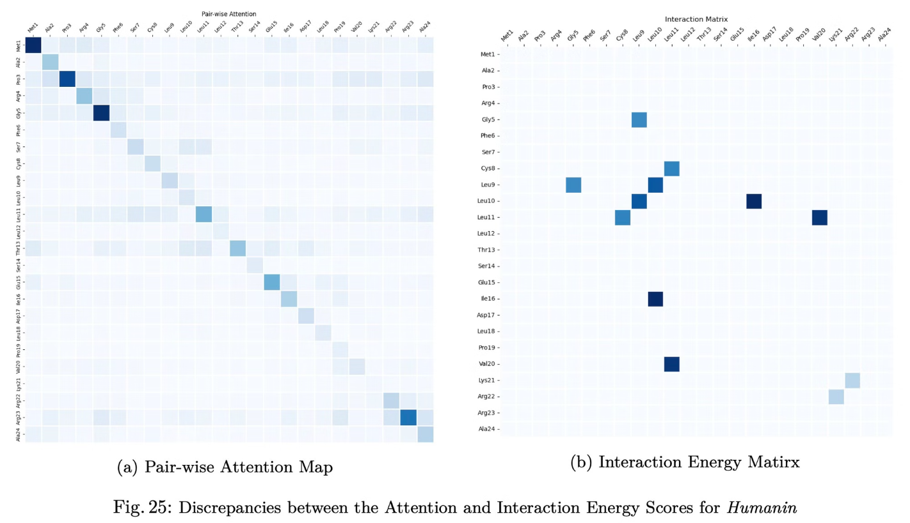
PA Results: Con-T and Humanin
Humanin: PA focuses on scattered residues, failing to capture the helix important for function.

Slide 25
Conclusion and Future Directions
Current explainability methods struggle to accurately reflect established measures of protein structure, such as evolutionary conservation and interaction energies.
Integrated Gradients (IG),
Integrated Directional Gradients (IDG), and
Pairwise Attention (PA)
Extended 25-page manuscript
Moving forward, explore refining the definition of "ground truth" by considering alternative metrics or experimental validation.
Additionally, improve existing XAI methods to better align with the complexities of advanced protein folding models like AlphaFold.

